Slide 1
The Task Titans-
Task Buddy
Christina Casey, Matt Lorenzo, Emily Knoll, Katelyn Crumpacker, Brooke Ritter

Slide 2
Problem
Life is busy - How can we manage tasks efficiently?
stress & overwhelming workload
poor time management
scattered to-do lists
scattered calendars
lack of prioritization
lack of organization
lack of accountability
procrastination
insufficient resources!

Slide 3
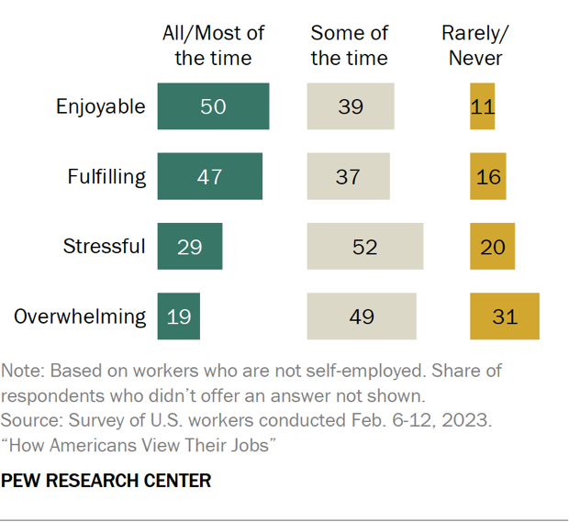
Stress in the workplace
According to Pew Research, 19% of workers find their job to be overwhelming the majority of the time and 49% said their job was overwhelming some of the time
This means 68% of people in the workplace who have issues with being overwhelmed and need tools to minimize their stress
[1]

Slide 4
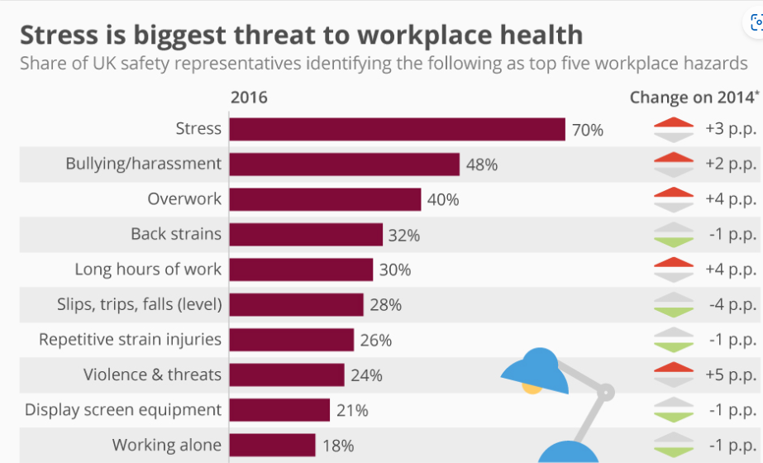
[2]

Slide 5
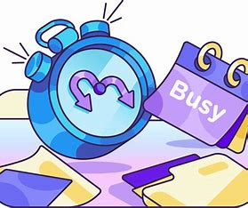
Lack of organization
82% of people don’t use a time management system and time management is a common barrier against productivity in the workplace and in education [3]
People think they don’t need them, but time management systems are extremely effective in reducing procrastination and increasing productivity

Slide 6
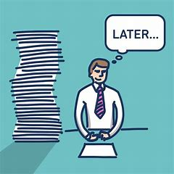
Addressing the problem
Who is affected by this problem?
People in the workplace and students often struggle with stress, time management, procrastination, etc
What platforms do we use to manage our lives?
Often people don’t use time management systems in their lives, but instead use like a notes app that isn’t useful unless the user remembers to look at it

Slide 7
Addressing the problem
Are there any constraints we need to consider?
The solution needs to be simple as not to further overwhelm users
The functionalities of the application should take a minimal amount of time to not take away from time to be productive
What functions do we think are necessary to include?
Allowing the users to remind themselves of tasks
Have a to-do list and/or calendar of tasks
Have a list of priority of tasks

Slide 8
Solution
Task Buddy
Provide users with an efficient and user-friendly platform for managing their tasks and responsibilities
Reliable
Ensures that users can access and manage their tasks regardless of network connectivity and can navigate through their tasks without experiencing delays
Organized
Users will have the ability to have different task lists, sub-tasks, and overlapping tasks
Intuitive Navigation
Establish design patterns that users can effortlessly navigate through
Adaptable
Adapts to different screen sizes

Slide 9
Maintenance & Deployment Plan
Automated continuous development through Jenkins
Corrective: Squash bugs as they arise
Preventative: update app to improve security
Perfective: Adding new features and listening to users
Adaptive: Make sure app is compatible with all devices and systems
Monitor app performance with alerts for bad performance
Continuous testing and code reviewing
Create a feedback system for users

Slide 10
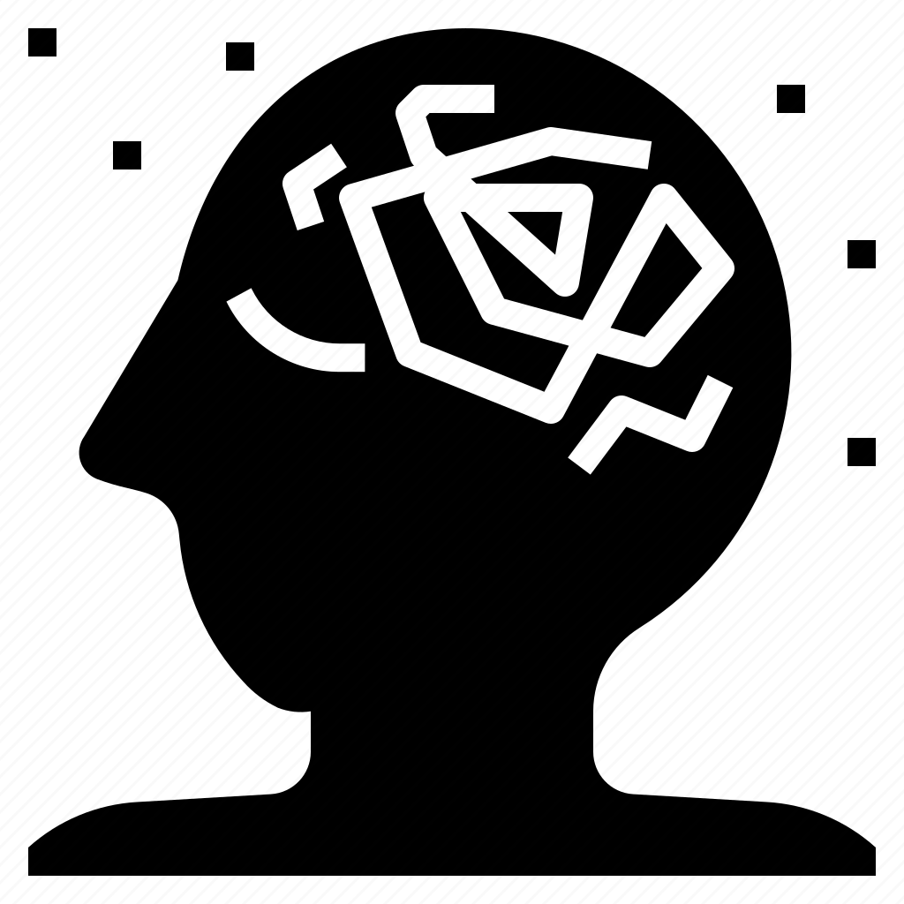
Related Work
Why Keep Organized?
The “Zeigarnik Effect” describes how planning a “to-do” list reduces stress on the brain
A study conducted by Dr. Sarina Schrager and Dr. Elizabeth Sadowski reviewed the effect of organization on productivity
https://www.ncbi.nlm.nih.gov/pmc/articles/PMC4763375/#:~:text=The%20so-called%20%E2%80%9CZeigarnik%20Effect%E2%80%9D%20demonstrated%20that%20the%20act,cross%20off%20the%20first%20thing%20on%20their%20list.
Notes:
Dr. Schrager and Dr. Sadowski conducted a research study on how organized necessary tasks affects an individual’s productivity level.

Slide 11
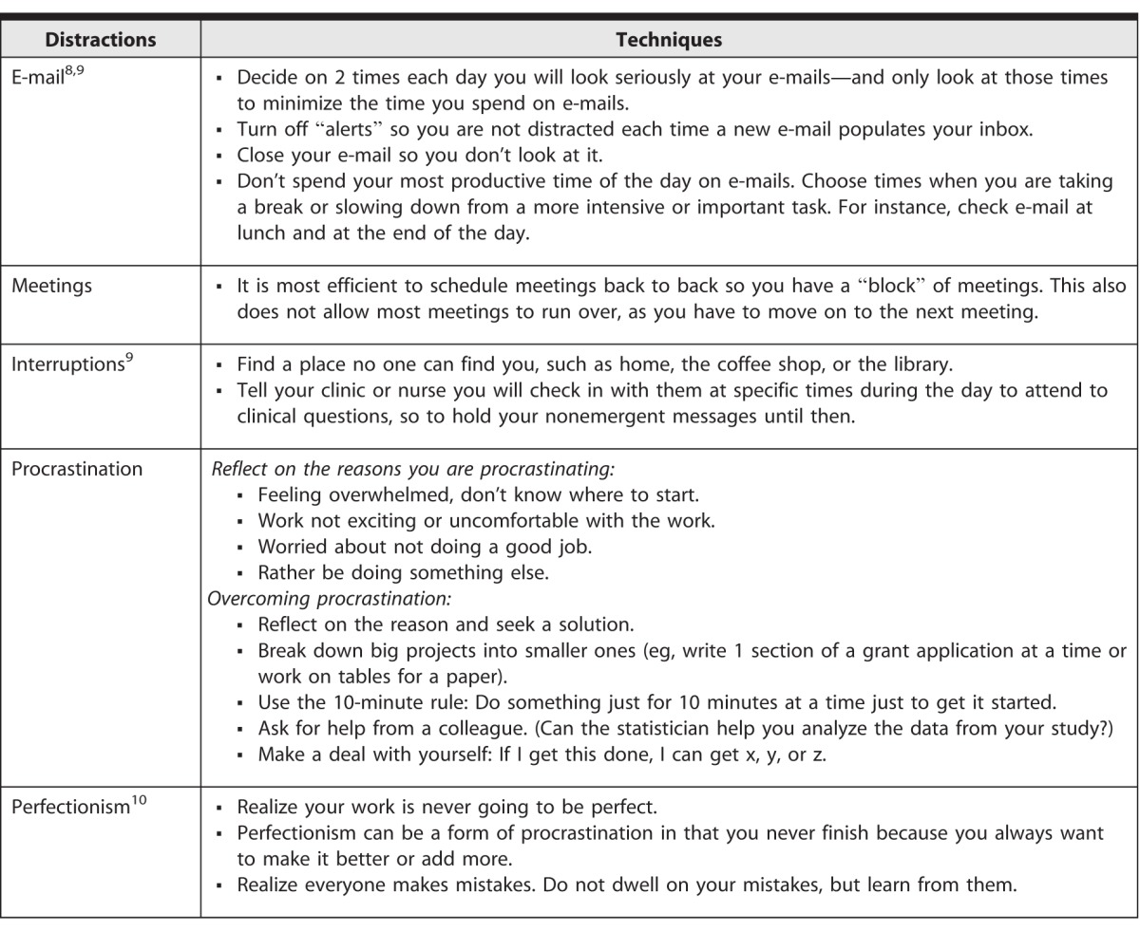
Steps:
Determine whether you say “yes” or “no” to a task
Make everything count twice
Develop techniques to minimize distractions
Prioritize the tasks on the “to-do” list
Notes:
The study utilized Stephen Covey’s The 7 Habits of Highly Effective People to organize and prioritize tasks.

Slide 12
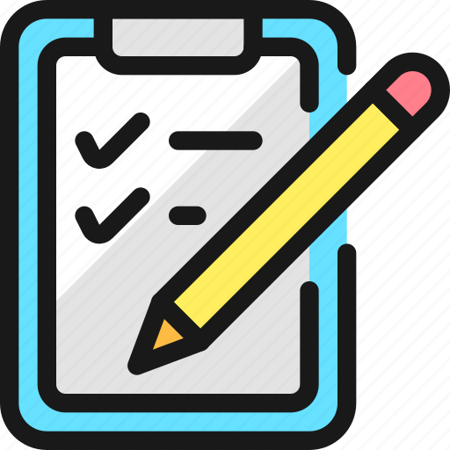
What did the study show?
The study concluded that organizing “to-do” list tasks helps prioritize the tasks
The structure of prioritizing tasks reduces stress on the brain enabling for more productive work

Slide 13
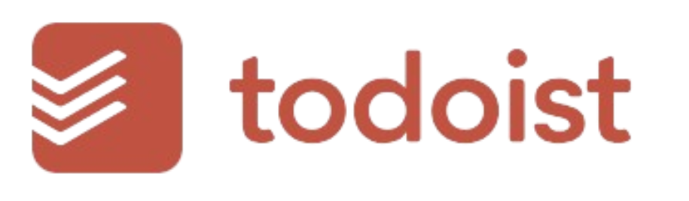
Task Buddy: How it’s Different from Other Task Apps
Task Buddy:
Allows for task prioritization
Detailed tasks with reminders, descriptions, and deadlines
One task can have multiple components or sub tasks
Todoist:
Allows for teams to have one platform for tasks
Task title and due date
Calendar feature showcasing all tasks
VS
Notes:
Todoist is another task organization app that allows for users to input tasks to track them. This app offers a calendar feature that showcases all the due tasks on a calendar. In addition one feature this app has that Task Buddy doesn’t is a team feature that allows users to collaborate with team members to track all tasks for a project. Although this is an effective to do list application, Task Buddy’s prioritization feature allows to further the Zeigarnik effect by allowing for maximum organization.

Slide 14
Concepts Used
1.
2.
3.
Agile Development
Unit Testing
CI/CD
Flexibility of this method allowed us to adapt and change our design often
Unit Testing allowed us to ensure that different parts of the design would work well before bringing everything together
CI/CD enables faster and more frequent releases which allows us to put out new features and updates to users more quickly

Slide 15
Future Work
Collaborative features: share to-do lists or assign tasks
Analytics and Insights: provide users with insights and analytics about their productivity and task completion rates
Integrate with other services: integrate with other applications such as calendars, email clients, and project management tools

Slide 16
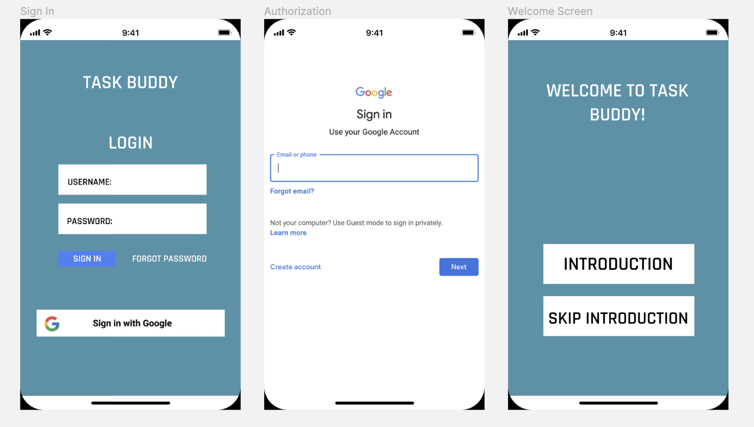
Use Case: Account Creation

Slide 17
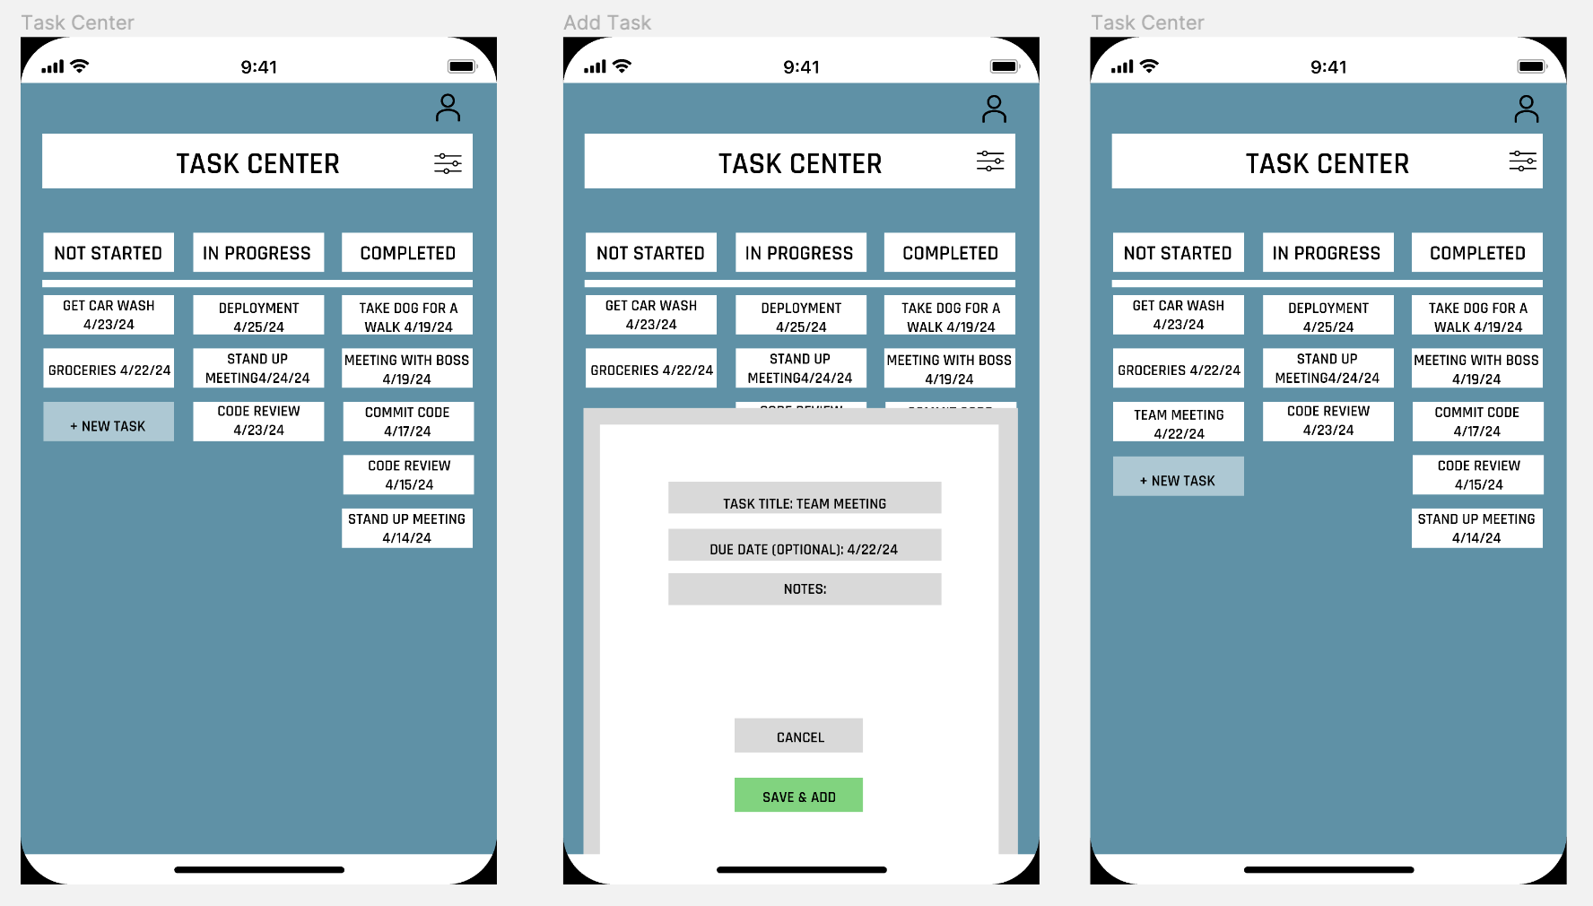
Use Case: Task Creation

Slide 18
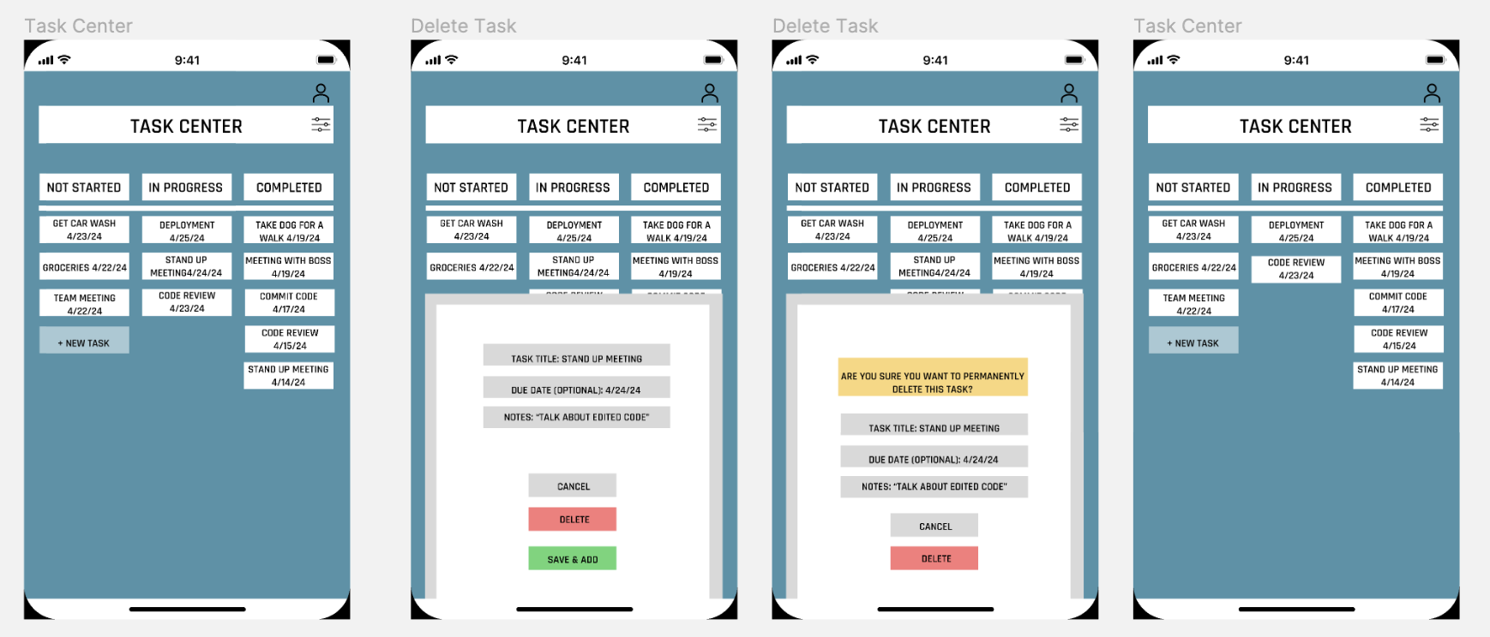
Use Case: Task Deletion

Slide 19
Thank You!

Slide 20
Sources
[1]J. Horowitz and K. Parker, “How Americans View Their Jobs,” Pew Research Center’s Social & Demographic Trends Project, Mar. 30, 2023. https://www.pewresearch.org/social-trends/2023/03/30/how-americans-view-their-jobs/
[2]M. Armstrong, “Infographic: Stress Is Biggest Threat To Workplace Health,” Statista Infographics, Oct. 24, 2016. https://www.statista.com/chart/6177/stress-is-biggest-threat-to-workplace-health/
[3]“Time management statistics,” Clockify, 2021. https://clockify.me/time-management-statistics

